Slide 1



STEM 2002 – Problem solving with computers
spatial analyses & point patterns
Dr Frédérik Saltré
Global Ecology, Biological Science (213)
frederik.saltre@flinders.edu.au @FredSaltre

Slide 2

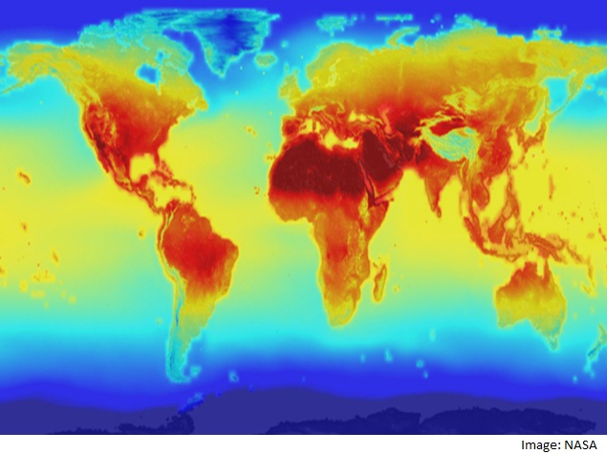
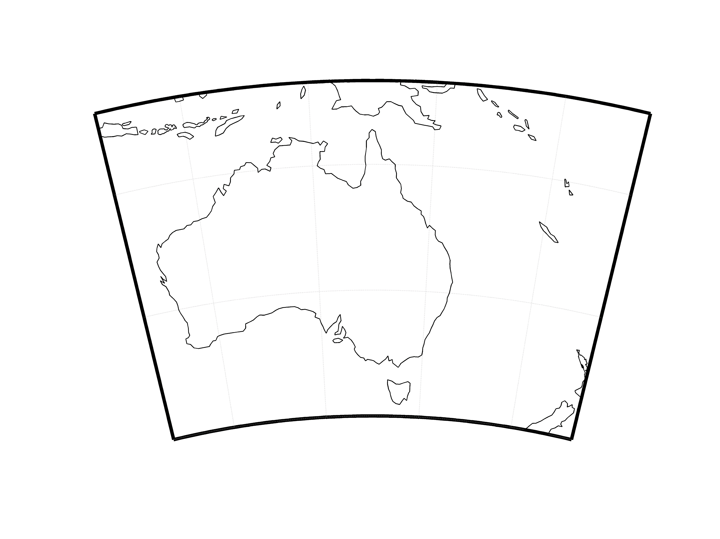

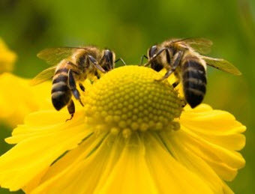

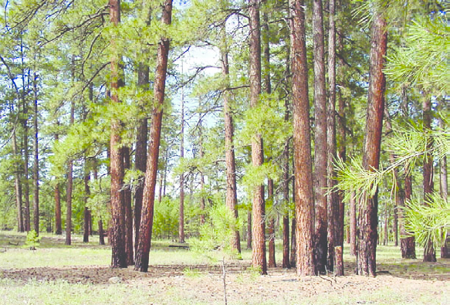










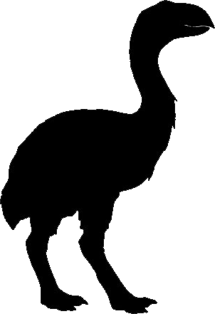



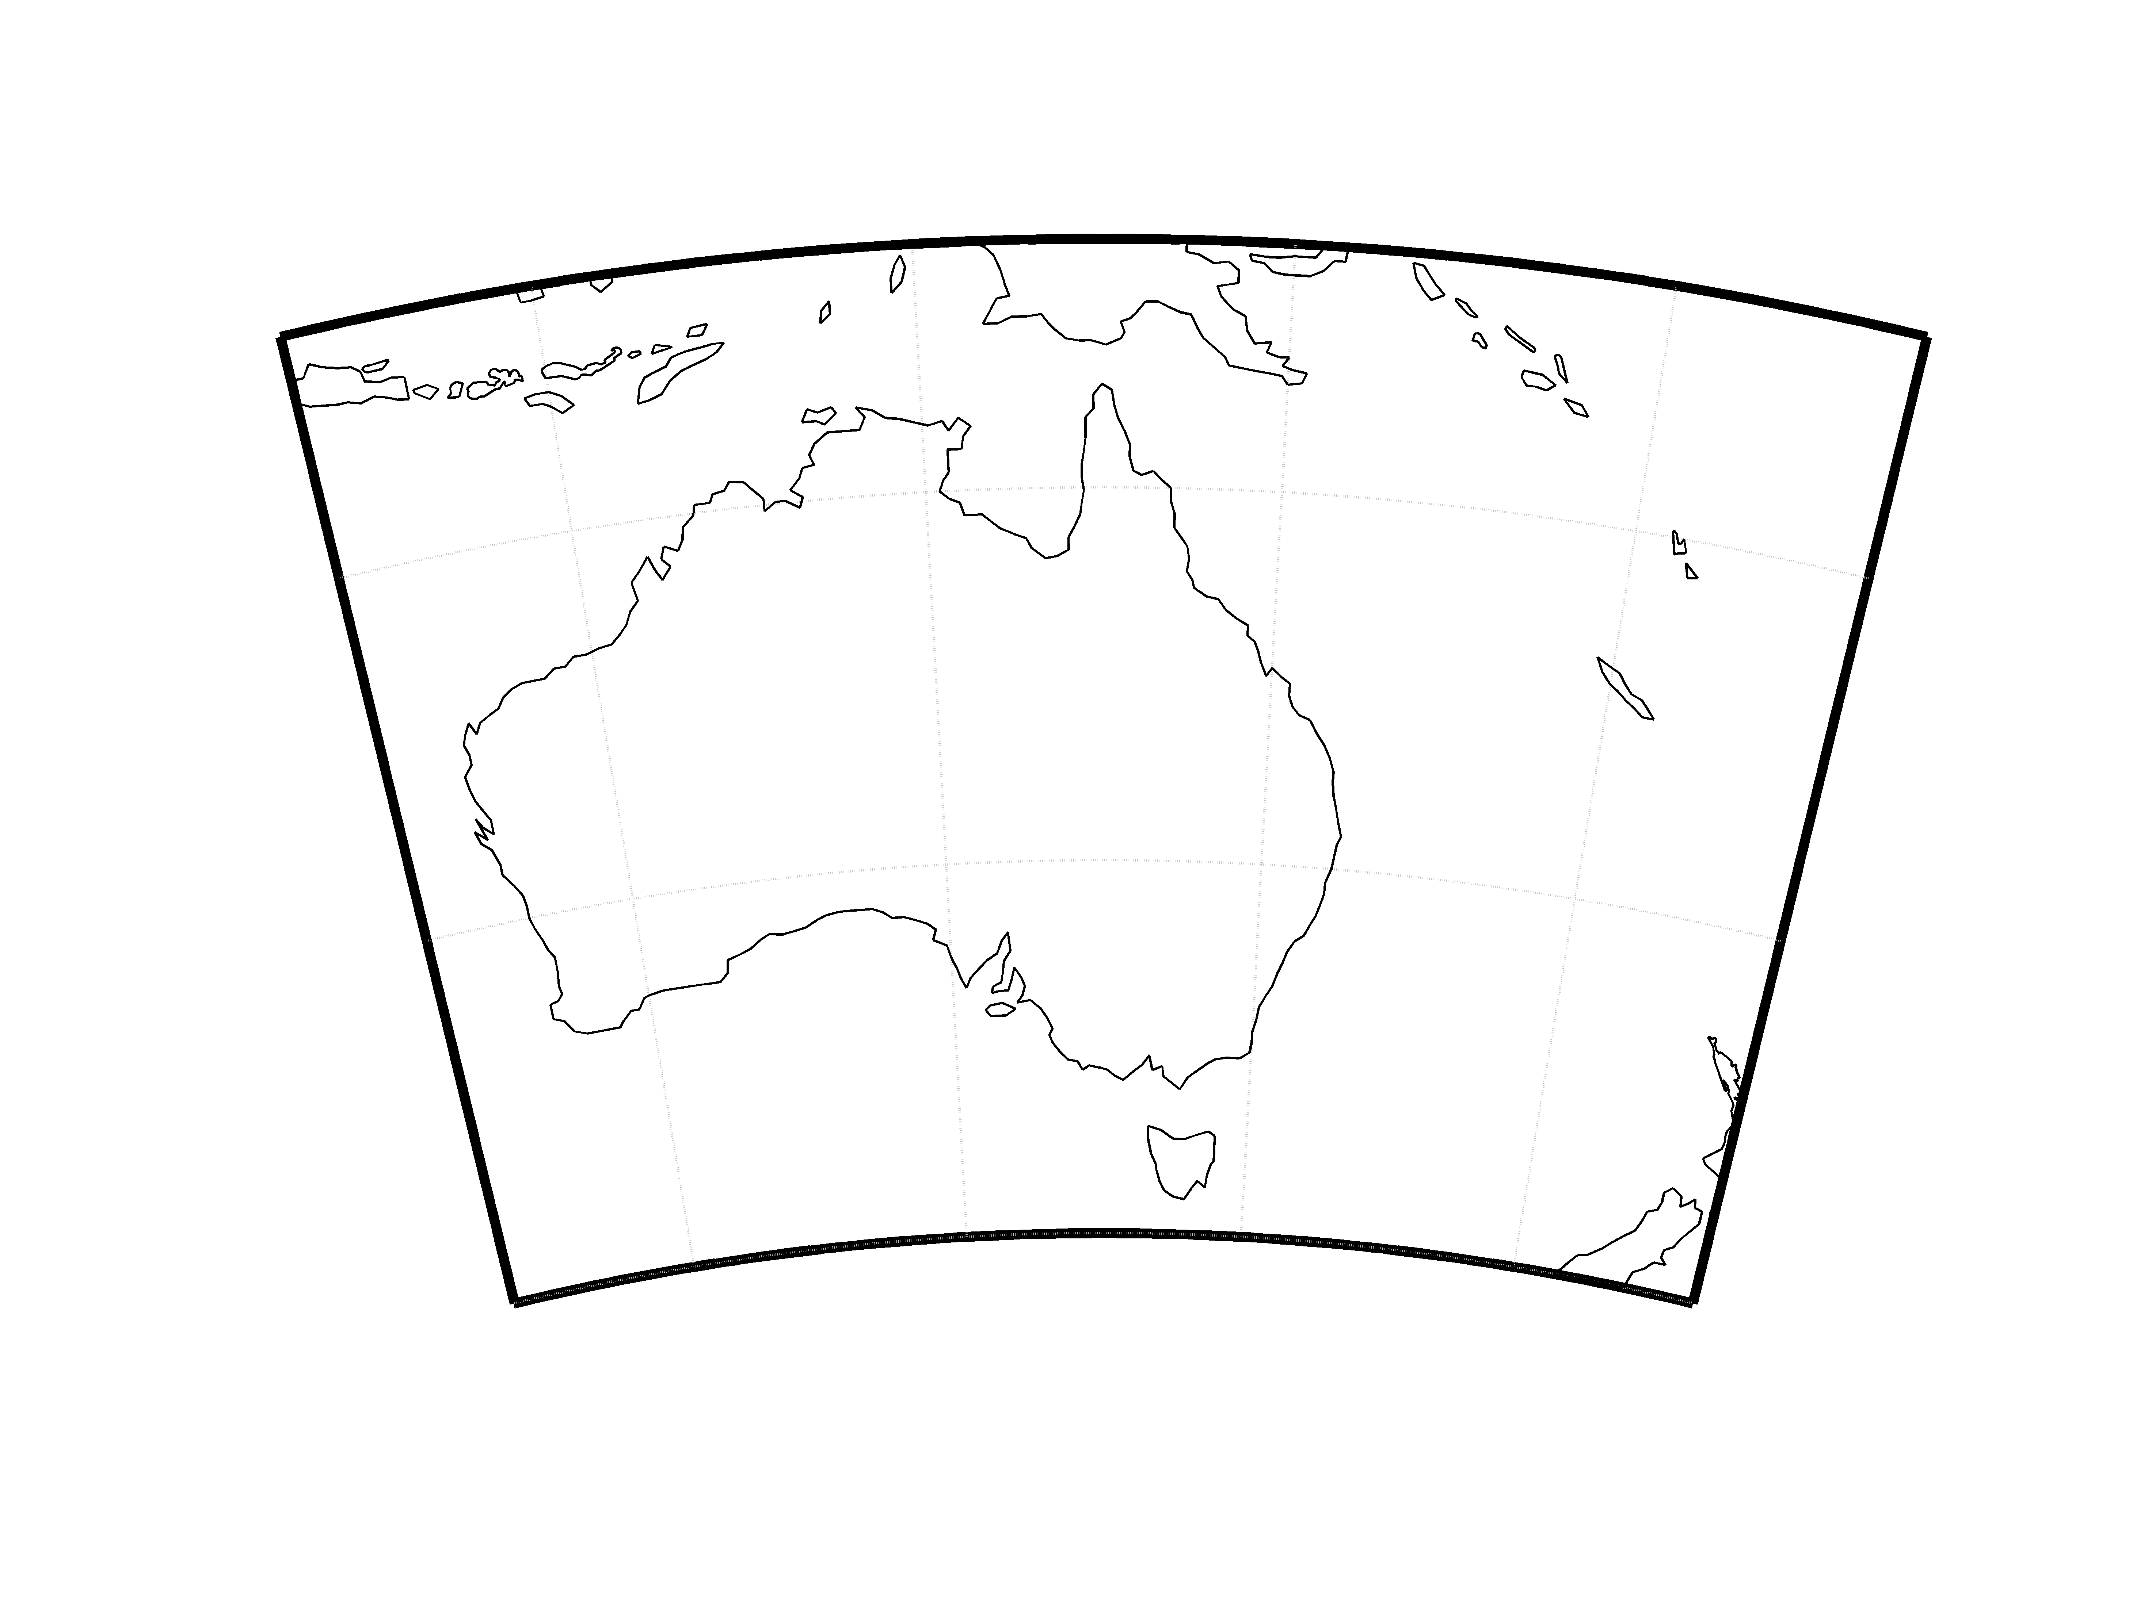
spatial structure: an important driver of ecological processes
spatial variation has been often considered as undesirable noise in ecological studies
many statistical methods assume a random spatial distribution
STEM 2002/8005 ⎯ spatial analyses & point patterns

Slide 3
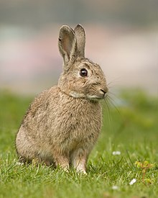
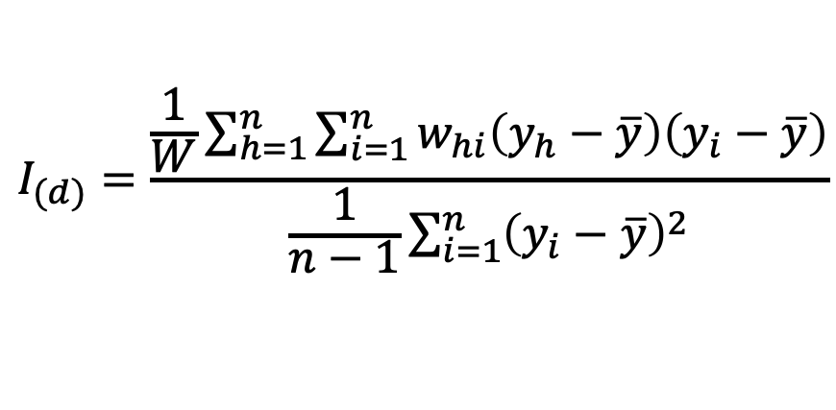
measures of spatial autocorrelation: Moran’s I and correlograms
covariance between nearby observation
current distribution of Oryctolagus cuniculus
(European rabbit)
$$I_{(d)}=\frac{\frac{1}{W}\sum_{h=1}^{n}{\sum_{i=1}^{n}{w_{hi}\left(y_{h}−\overline{y}\right)\left(y_{i}−\overline{y}\right)}}}{\frac{1}{n−1}\sum_{i=1}^{n}{{\left(y_{i}−\overline{y}\right)}^{2}}}$$
1
0.5
Moran’s I
0
variance around the mean
-0.5
I estimates proportion of variance shared by observation of same variable at a given distance
-1
0
25
50
75
100
distance (km)
plot of I against distance = correlogram
Fox et al., 2015, Ecological Statistics (Oxford University Press)
Roy-Dufresne et al., 2019, Ecology & Evolution (in review)
STEM 2002/8005 ⎯ spatial analyses & point patterns

Slide 4
intensity & quadrat count
INTENSITY : average density of points = expected number of points per unit area
> T <- intensity(data)
constant
vary from location to location
QUADRAT COUNTS : divide study region into rectangles (‘quadrats’) of equal size, + count points in each rectangle
> Q <- quadratcount(data, nx=3, ny=3)
> Q
> plot(Q, add=TRUE)
STEM 2002/8005 ⎯ spatial analyses & point patterns

Slide 5
analysing pattern structure: interpoint interactions
stochastic dependence between the points in a point pattern
expect dependence to be strongest between points that are close to one another
> set.seed(42)
> clus <- rMatClust(30, 0.05, 4)
> regu <- rSSI(0.09, 70)
> inde <- rpoispp(100)
> plot(clus)
> plot(regu)
> plot(inde)
clustered
regular
random
Goreaud et al., 2002, Ecological Modelling 158:1-19; Ilian et al., 2008 (Wiley)
STEM 2002/8005 ⎯ spatial analyses & point patterns

Slide 6
analysing pattern structure: index vs function
index of dispersion:
index of randomness:
Ripley’s K-function
Besag’s L-function
Pair Correlation function
Clark-Evans index:
mean-direction index:
indices limited by lack of spatial scale representativity
clustered
regular
random
Goreaud et al., 2002, Ecological Modelling 158:1-19; Ilian et al., 2008 (Wiley)
STEM 2002/8005 ⎯ spatial analyses & point patterns

Slide 7
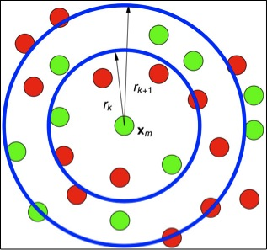
K-, L- and Pair Correlation functions
Ripley’s K function calculate how point pattern distributions can change with scale
clustered
regular
random
Goreaud et al., 2002, Ecological Modelling 158:1-19; Ilian et al., 2008 (Wiley)
STEM 2002/8005 ⎯ spatial analyses & point patterns

Slide 8
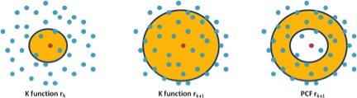
K-, L- and Pair Correlation functions
g (r)
r
PCF = spatial association within rings (≠ cumulative circles in K)
K = larger distances biased by shorter interaction -> obscures the spatial association at any given scale
clustered
regular
random
Goreaud et al., 2002, Ecological Modelling 158:1-19; Ilian et al., 2008 (Wiley)
STEM 2002/8005 ⎯ spatial analyses & point patterns

Slide 9
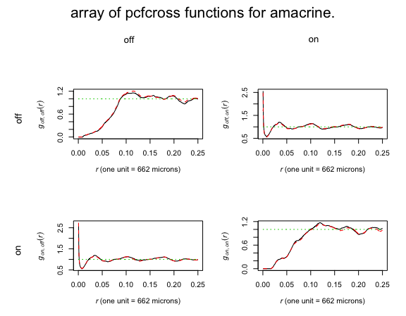
interaction between types: marked spatial patterns
In a multitype point pattern, there may be interaction between the points of different types, or
between points of the same type
> data (amacrine)
> plot(amacrine)
> plot(envelope(amacrine$on, pcf, nsim=100))
> plot(envelope(amacrine $off, pcf, nsim=100))
> plot(alltypes(amacrine, pcfcross))
STEM 2002/8005 ⎯ spatial analyses & point patterns

Slide 10
assignments
Using “KoalaNppSahul.csv”:
investigating the spatial autocorrelation of Npp
plot data
calculate the Moran’s I + plot the results
interpret
analysing Koala spatial pattern
estimate of the average intensity of trees (number of trees per unit area)
plot of the density
test for homogeneity (e.g., ‘quadratcount’ function with 4 quadrats)
compute an aggregation index (e.g., Clark and Evans) and a nearest distance function
calculate and plot an estimate of the pair correlation function using `pcf` and its confidence interval (i.e. envelope)
discuss and interpret your results
STEM 2002/8005 ⎯ spatial analyses & point patterns

